Slide 1
Predicting Maximum Temperature using Linear Regression
Summary Of Weather Dataset
By
Prem Ranjan
INSAID GCD, Cohort – Feb 2019
Date: 30-Jun-2019

Slide 2
Introduction
In this exercise, we will explore the basic use of Pandas and will cover the basic commands of Exploratory Data Analysis(EDA) which includes cleaning, munging, combining, reshaping, slicing, dicing, and transforming data for analysis purpose. We will also develop a regression model to predict the Maximum Temperature.
Problem Statement
Based on the weather data in the Summary of Weather dataset, develop a predictive model to determine the Maximum Temperature on a given day.
Exploratory Data Analysis
Understand the data by EDA and derive simple models with Pandas as baseline. EDA is a critical and first step in analyzing the data and we do this for below reasons :
Finding patterns in Data
Determining relationships in Data
Checking of assumptions
Preliminary selection of appropriate models
Detection of mistakes

Slide 3
Understanding the Data
The dataset contains information on weather conditions recorded on each day at various weather stations around the world. Information includes precipitation, snowfall, temperatures, wind speed and whether the day included thunder storms or other poor weather conditions.
The dataset has 31 columns.
The data has a total of 119040 rows.
The dataset has Integer, Float & Object data types.
There are several columns with Null data.
The dataset contains data for the years 1940 to 1945.
Maximum Temperature range from 27 to 50 degree Celsius.
Minimum Temperature range from 17 to 34 degree Celsius.
A subset if the data attributes is provided in the next slide.

Slide 4
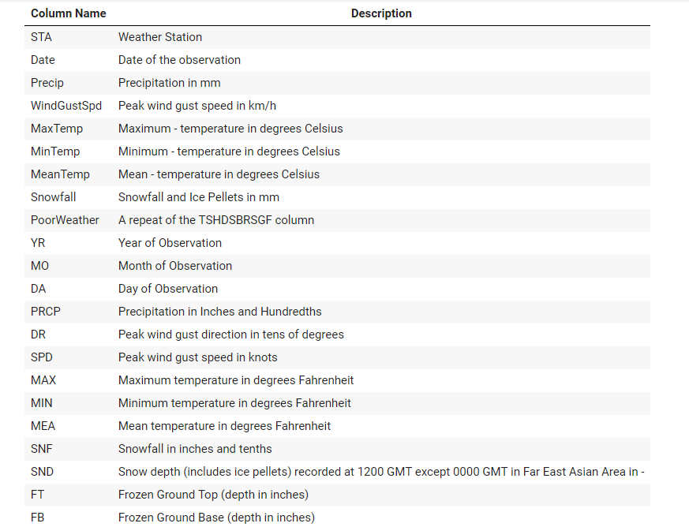
Dataset Attributes

Slide 5
Initial Observations
Dataset comprises of 10 duplicate rows.
There are several columns with missing values in this data set. e.g. FT, FB, FTI, ITH, PGT etc.
The dataset contains the value “T” for some of the columns. In meteorology, the word "trace" is used to describe a very small amount of precipitation that results in no measurable accumulation. Trace amounts of precipitation are abbreviated by the capital letter "T", often placed in parenthesis (T). The numerical equivalent of "trace" or "T" is 0.00.
Several columns are not required for building the predictive model / algorithm and needs to be dropped of the below reasons,
The columns has a high percentage of Null data.
Some of the columns are duplicate e.g. MIN, MAX, MEA, which has the same temperature data in degree Fahrenheit.
Several columns are highly co-related e.g. MINTEMP with MeanTemp
Few columns have Null values, which will be replaced using FILLNA.
Data Profiling of the dataset would also provide a solid understanding of your data.

Slide 6
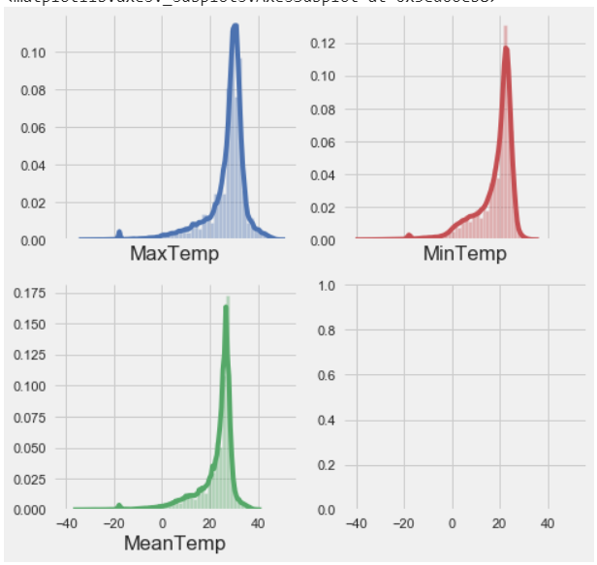
Distribution Plot of the key features

Slide 7
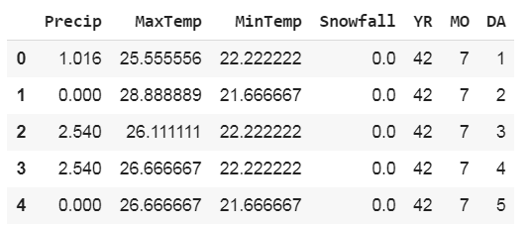
Data snapshot after processing

Slide 8
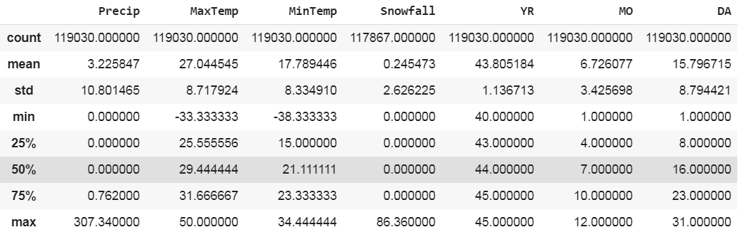
Statistical details of the data

Slide 9
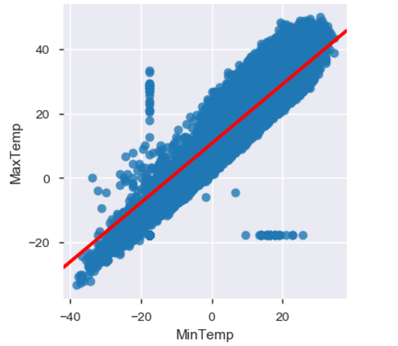
Distribution of Maximum Temperature & Minimum Temperature after processing

Slide 10
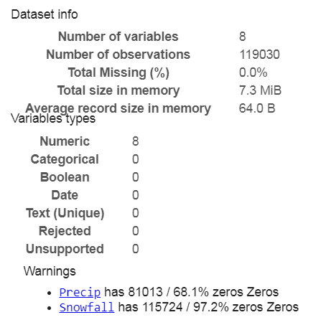
Dataset information after processing
Dataset Info
Variable Types

Slide 11
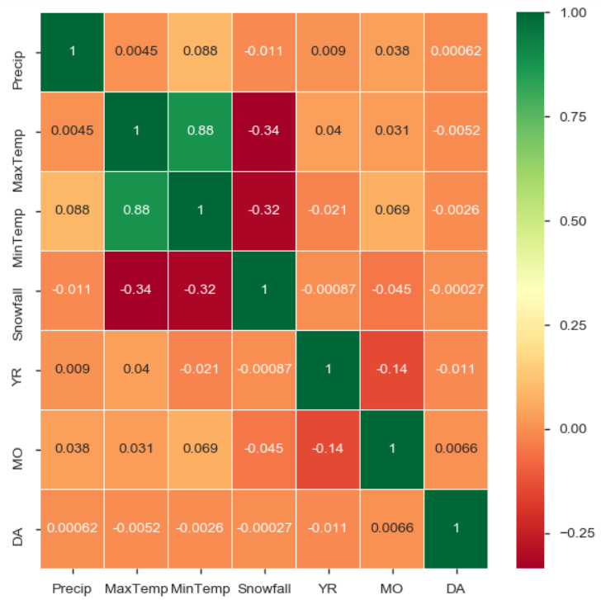
Correlation between data
Observations
MaxTemp has a good positive co-relation with the MinTemp.
All other data elements have low correlation.

Slide 12
Predictive Modeling
EDA helped us understand the data. But to predict the Maximum temperature, we would need a Regression Algorithm.
We will use the Linear Regression to make the model.
To apply any machine learning algorithm on your dataset, basically there are 4 steps:
Load the algorithm
Instantiate and Fit the model to the training dataset
Prediction on the test set
Calculating Root mean square error
The Maximum & Minimum Temperature are selected as the key features.
We have used Linear Regression to build the model. We also used GridSearchCV.

Slide 13
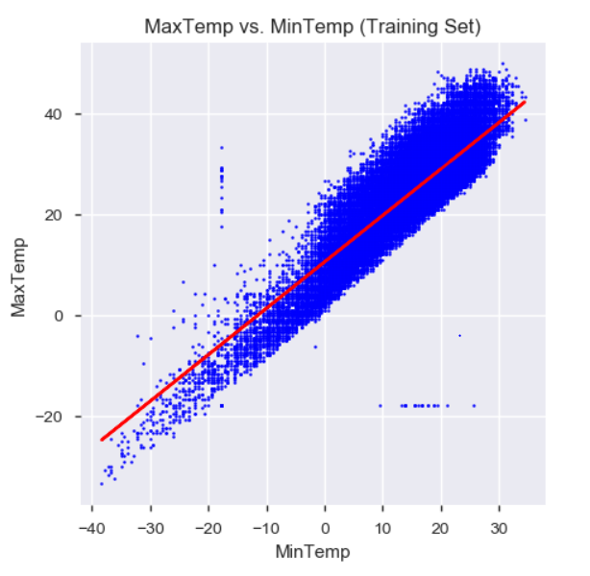
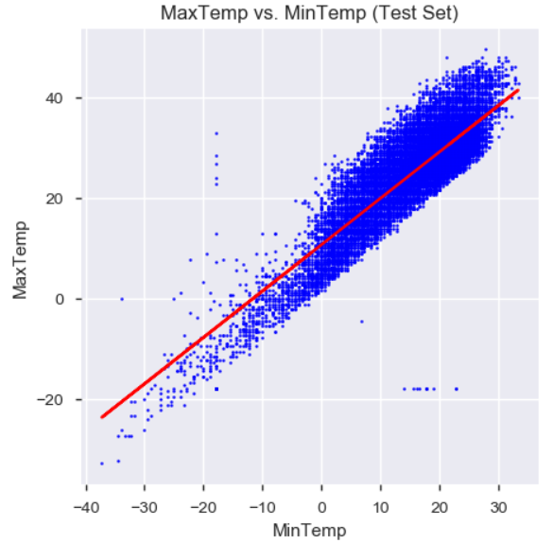
Distribution of Training & Test data

Slide 14
Conclusion
The dataset had several columns with Null values.
The dataset has multiple duplicate columns with same data and different units.
We used linear regression to build a model to predict the Maximum Temperature.
Maximum Temperature has the highest co-relation with the Minimum & Mean Temperature.
The model came up with a RMSE of 4.16779646464 for test data and RMSE of 4.16590620012 for training data.
The model has a R_Squared score of 0.7640893959408953 and an Adjusted_R_Squared score of 0.7640814677716501.
The dataset does not have enough parameters to build a linear regression model with higher accuracy.

Slide 15
Thank You

